Slide 1

TEAM MEMBERS:
Encrypted data transfer platform with QR code and
Secure Shell based key-exchange mechanism
TEAM GUIDE:
Daniel Mark
Harrison Mathew N
Sajwa Furood I
DR. A JANANI.

Slide 2
SUGGESTIONS AND COMMENTS
To follow standard slide show format.
Add legend to the octopus diagram.

Slide 3
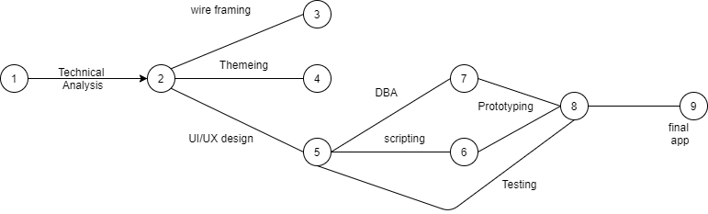
PERT CHART:
8 days
9 days
9 days
6 days
10 days
10 days
5 days
5 days

Slide 4
Gantt Chart
Need analysis | 7
Functional analysis |  | 10
Specifications |  |  | 7
Technical Analysis |  |  |  | 10
Wire-framing |  |  |  |  | 8
Theming |  |  |  |  |  | 5
UI/UX design |  |  |  |  |  |  | 6
DBA |  |  |  |  |  |  |  | 9
Scripting |  |  |  |  |  |  |  |  | 10
Prototyping |  |  |  |  |  |  |  |  |  | 9
Testing |  |  |  |  |  |  |  |  |  |  | 5
Revision |  |  |  |  |  |  |  |  |  |  |  | 3
18/12
24/12
4/1
11/1
21/1
28/1
2/2
8/2
16/2
25/2
4/3
8/3
10/3
0th review
1st review
2nd review

Slide 5
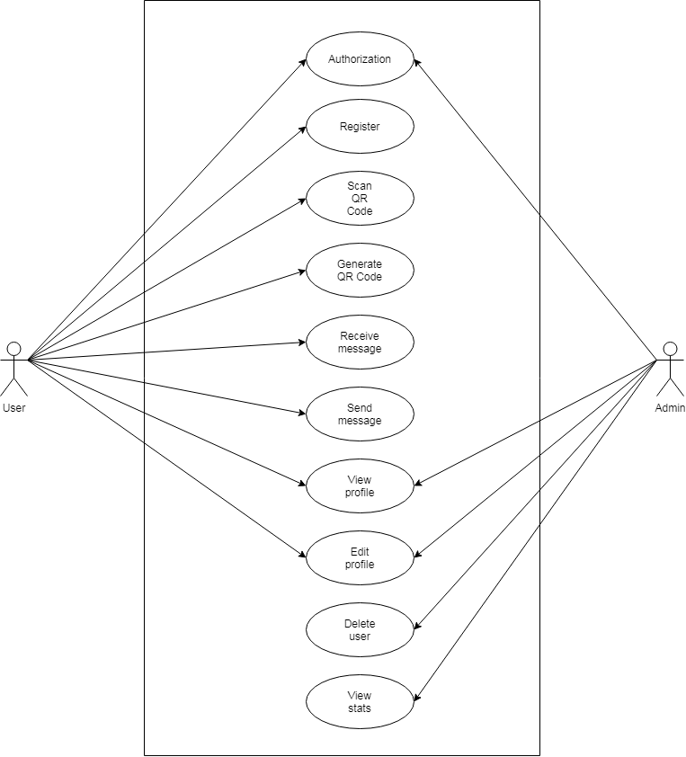
USE CASE DIAGRAM:

Slide 6
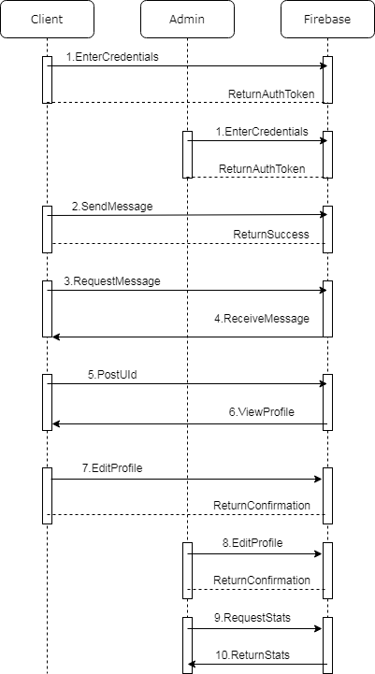
SEQUENCE DIAGRAM:

Slide 7
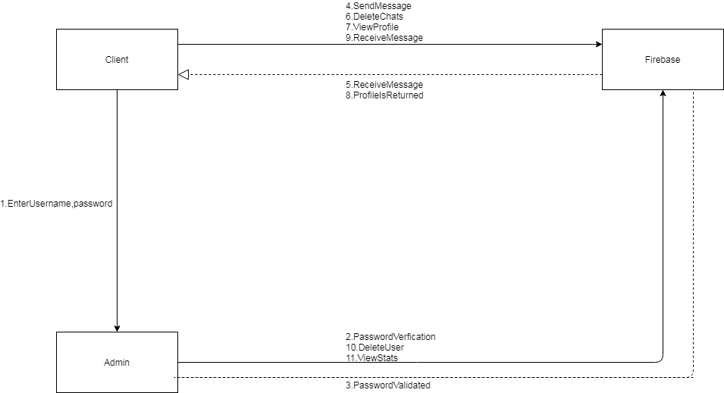
COLLABORATION DIAGRAM:

Slide 8
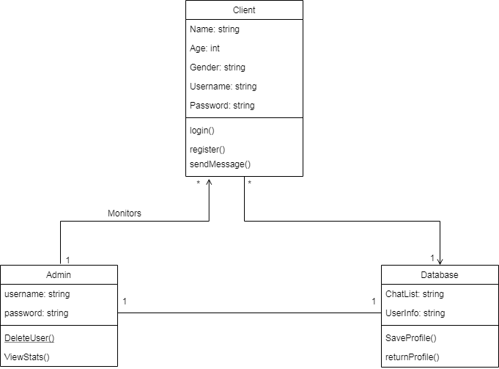
CLASS DIAGRAM:

Slide 9
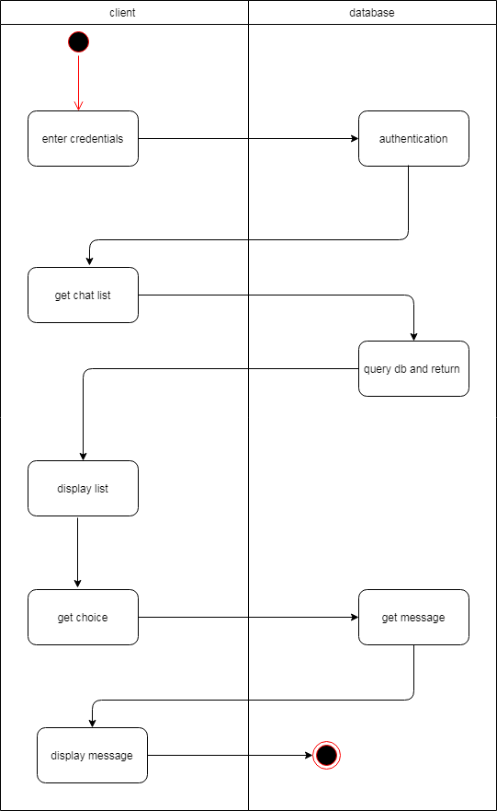
ACTIVITY DIAGRAM:

Slide 10
WORK DONE SO FAR:

Slide 11
WORK DONE SO FAR:

